Slide 1


Data-Driven Online Learning Platform
Welcome to our innovative data-driven online learning platform, designed to empower learners with personalized, effective, and engaging educational experiences.
by Neville Shem

Slide 2
The Problem We're Solving
Lack of Personalization
Limited Engagement
Data-Driven Insights Missing
Traditional learning methods often fail to cater to individual learning styles and needs, resulting in frustration and inefficiencies.
Passive learning approaches can lead to disengagement, boredom, and difficulty retaining information.
Many platforms lack the ability to analyze learning data, hindering the ability to identify and address individual challenges.

Slide 3

Our Unique Approach and Technology
1
Data-Driven Insights
Our platform provides teachers and administrators with valuable data-driven insights to improve curriculum development, personalize instruction, and measure student progress.

Slide 4

Proposed Solution
Leverage data analytics to improve course content and learning outcomes.
Support multiple languages and include accessibility features.

Slide 5

Our Target Market and Customer Segments
Underpriviledged Students
Higher Education Students
Working Professionals
Parents and Educators
Corporate Training Programs
Lifelong Learners

Slide 6
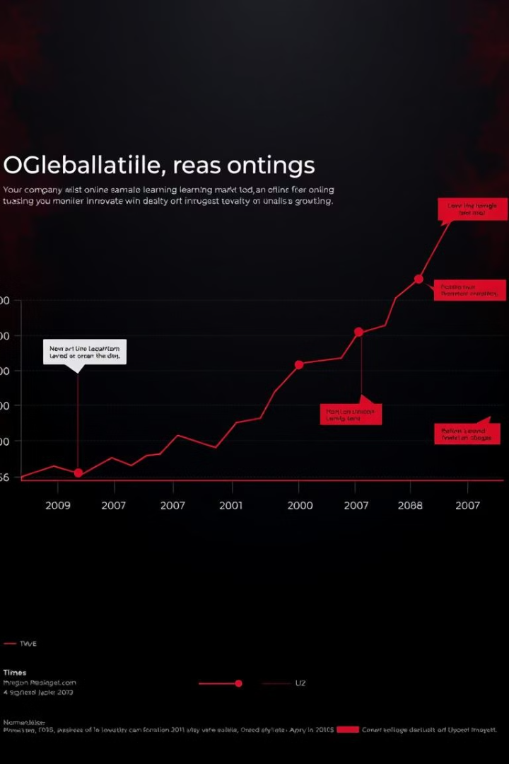



Competitive Landscape and Our Advantages
Existing Platforms
Many online learning platforms exist, but often lack personalization, data-driven insights, and engaging content.
Our Competitive Edge
We offer a unique blend of personalized learning, adaptive technology, and interactive experiences that sets us apart from the competition.
Market Leadership
Our goal is to become the leading provider of data-driven online learning solutions, empowering learners to achieve their full potential.

Slide 7
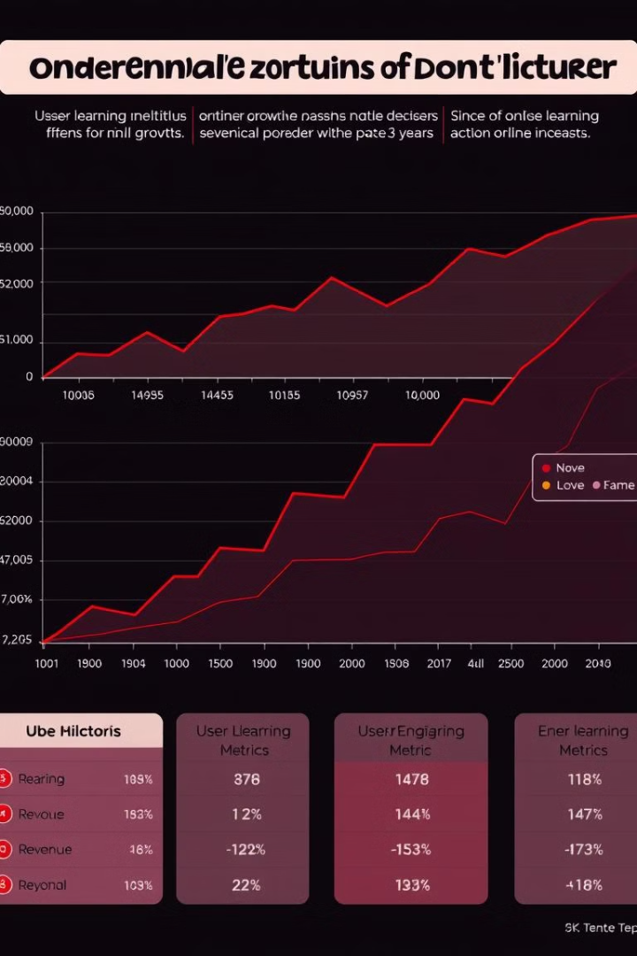
Database Design
Relationships between students, courses, assessments, and results to ensure comprehensive data tracking.
1
Students
Learner profiles and demographics.
2
Courses
Course offerings and content.
3
Enrollments
Tracks student enrollments and progress.
4
Assessments
Tests and evaluation data
5
Attendance
Tracks student attendance
6
Teachers
Teachers profile and demographics

Slide 8
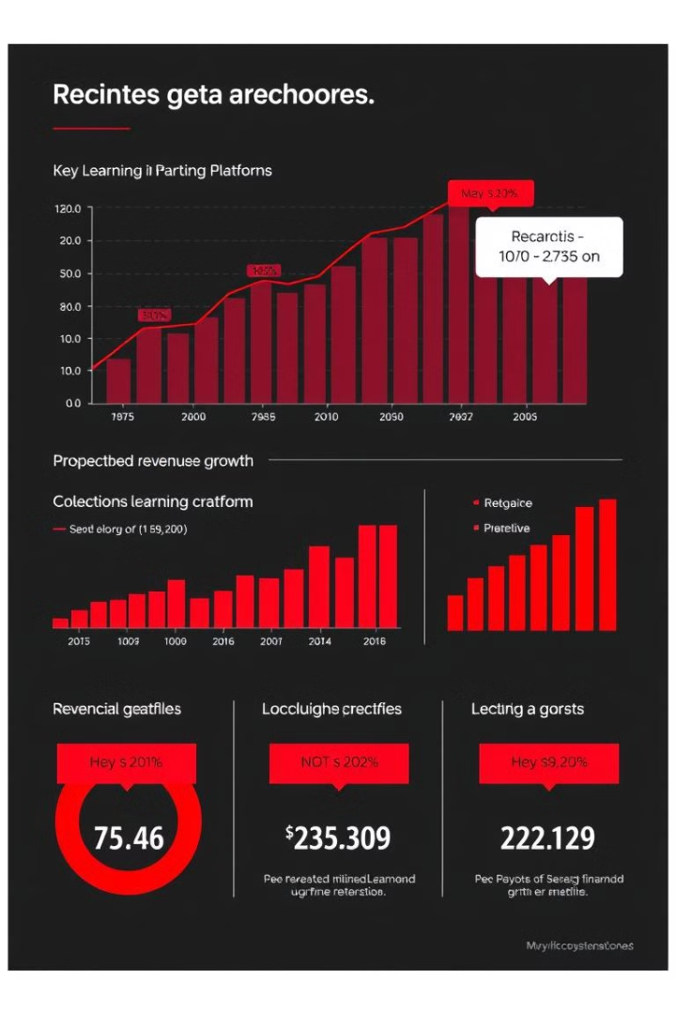


Business Model
User Growth
Future Expansion
We are focused on acquiring and retaining a large user base by providing a high-quality and engaging learning experience.
We plan to expand our platform and services to new markets and demographics to further drive growth.

Slide 9

Our Experienced Team
Neville Shem
CEO and Data .

Slide 10
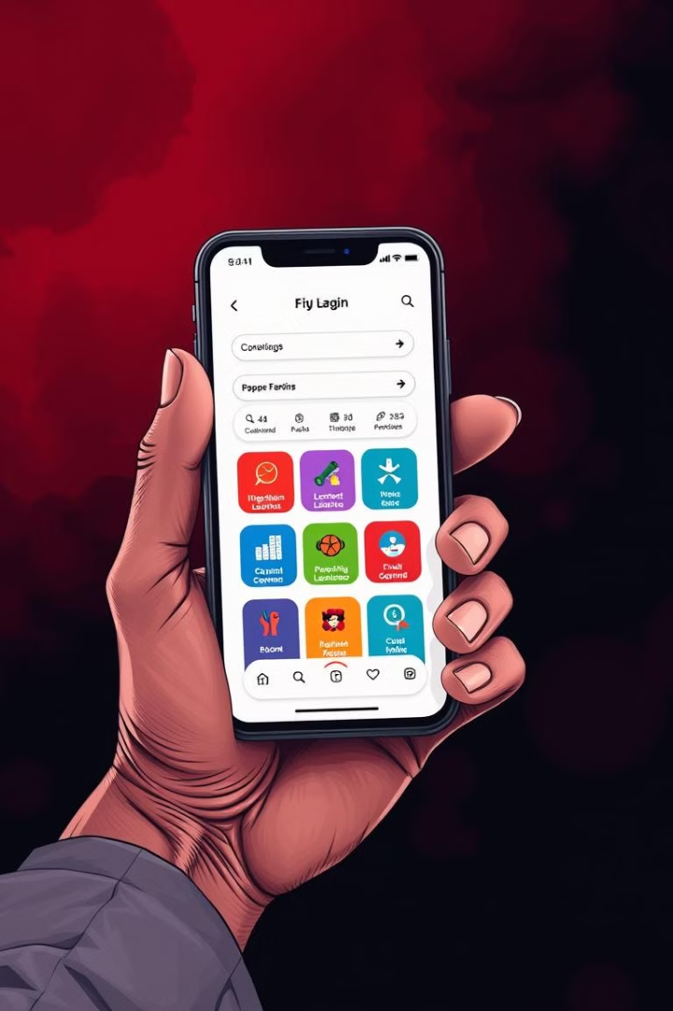
Call to Action and Next Steps
Join us in revolutionizing the future of online learning! We invite you to explore our platform, experience the difference, and become a part of our journey to empower learners worldwide.

